Slide 1

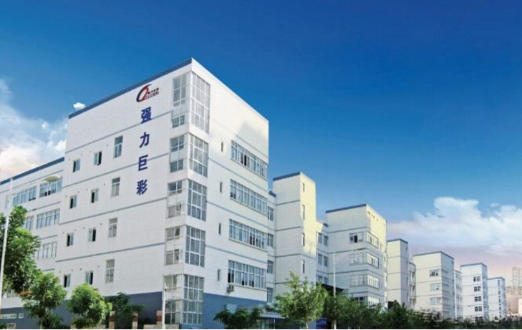
Xiamen Qiangli Opto-Electronic Technology Co., Ltd

Slide 2
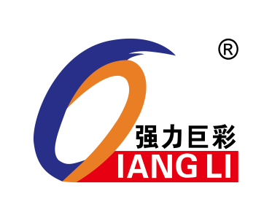
Enterprise

Slide 3

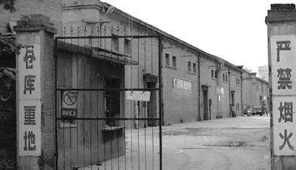
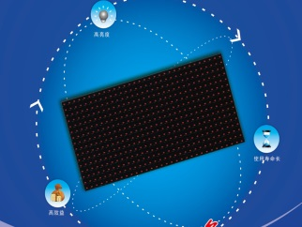
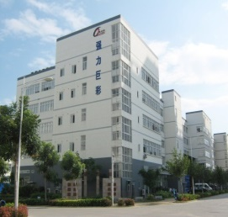
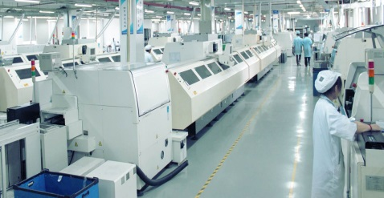
Enterprise History
2004
2007
2008
2009
Established In Quanzhou as Qianglijucai Opto-Electronic Co.,Ltd.
Create P10 products to establish industry status in China
Moved to Xiamen as Xiamen Qiangli Jucai Opto-Electronic Co.,Ltd. and import the Panasonic automatic equipment
Own 37 pieces of production line ,transform to full color modules and create economy of scales

Slide 4
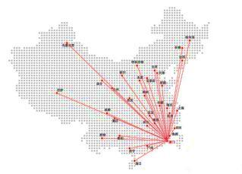
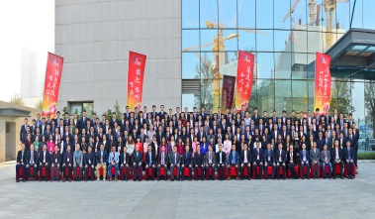
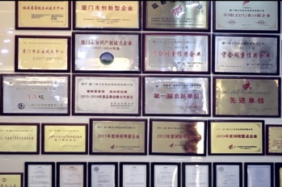
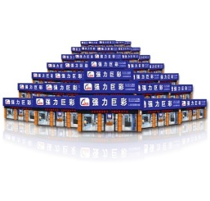
Enterprise History
2011
2013
2014
2015
2017
Output value of more than $400 million,
Module output is NO1 in this industry.
Start distributor channel across in China and explore the overseas market
More than 200 agent in China, and 2000 cooperation project partners,
Output value is over $150 million
We receive lots of rewards and honor .Output value is over $230 million
81pieces imported automatic production line ，Output value of more than $260 million, heading for the world brand

Slide 5
Present
Total Turnover US$ 400million For 2017
Employee 2000 people
Capacity >5.5 million pcs modul monthly
(equal 200,000 sq.m)
Panasonic NPM SMD machine around 300 set
R&D depart 120 person
China National Level Lab & Research Center

Slide 6

Strength

Slide 7
R & D strength
Unit：million RMB
R & D Investment Increasing by 200% every year.
R & D Investment 60 million RMB(60 crore)

Slide 8
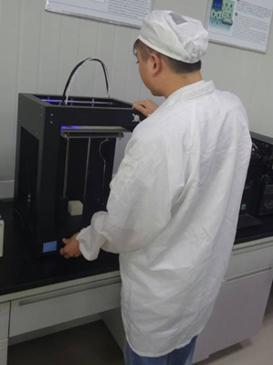
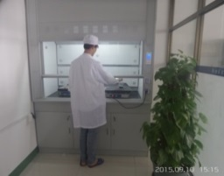
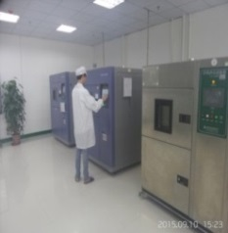
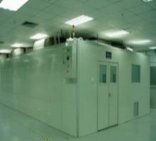
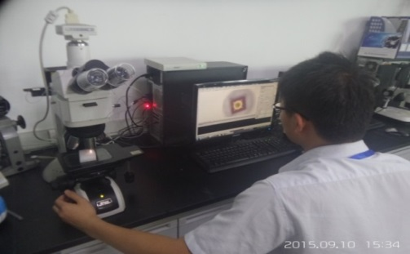
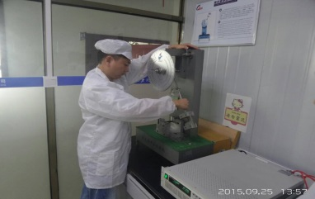
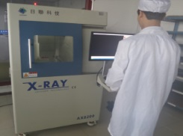
R & D strength--
R&D facilities
Technology center area:
1750 square meters
R&D facilities: 188sets，worth 54.38 million RMB
7 professional experiment systems
China National Level Lab & Research Center
Electronic Lab
Chemical Lab
Environmental Lab
DS-ORT
Failure Analysis Lab
Mechanical Laboratory
EMC Lab

Slide 9
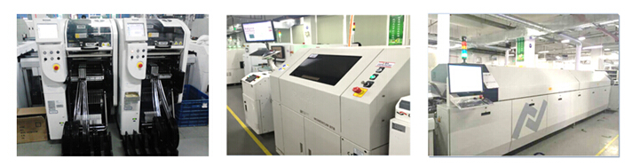
Production strength--
World class Equipment
Imported Sophisticated Equipment's accounts for 65%;
Domestic Sophisticated Equipment's accounts for 35%.
200 pcs SMT machine - Japan
Automatic screen printer--USA
Reflow Soldering—Germany
Accuracy of NPM surface mount placement machine is 0.01 MM

Slide 10
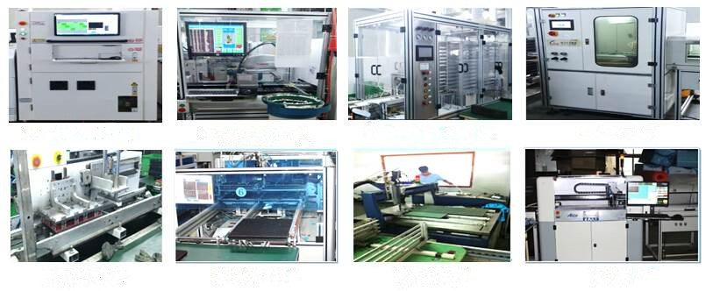
Production strength--
Sophisticated Equipment
Production strength--
Sophisticated Equipment
SPI on-line automatic detection
Circuit board assembly robot
automatic online dispensing machine
automatic spray light oil machine
automatic screwing machine
automatic potting machine
automatic ink-jet device
automatic assembly pan

Slide 11
Production strength--
Scale & Capacity
Largest scale in the industry
Capacity per month ：5.5 million pieces modules （DIP and SMD）
Automation coverage is above 85%（industry's highest ）
SMT line ：200 pieces（Panasonic NPM）
Fully automatic assembly lines：15
Equipped with sheet metal and plastic injection(Mask) workshop

Slide 12
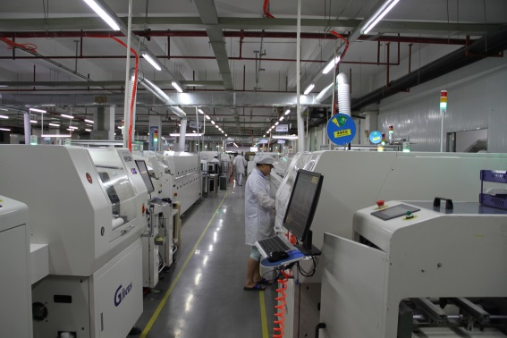
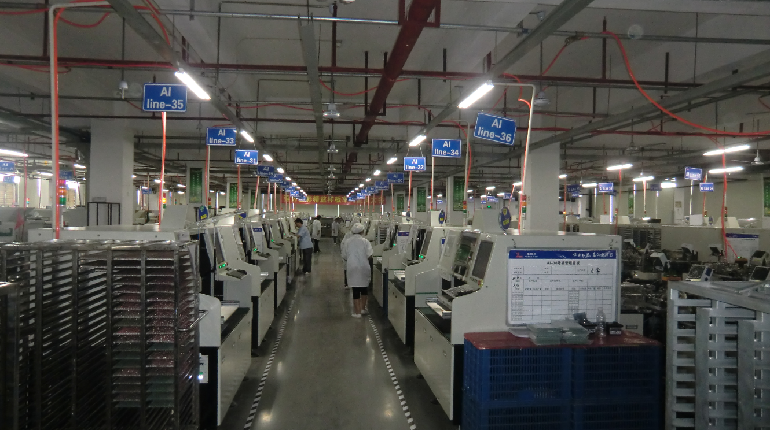
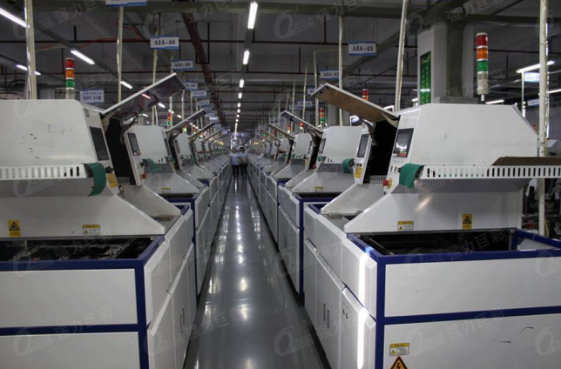
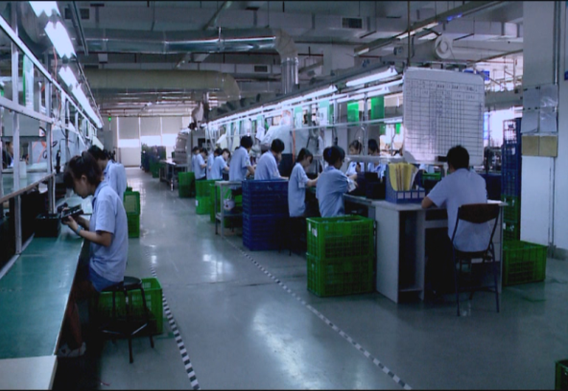
Company Profile

Slide 13
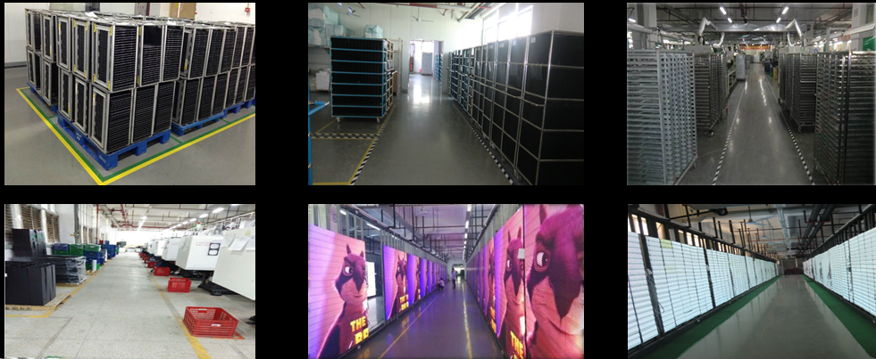
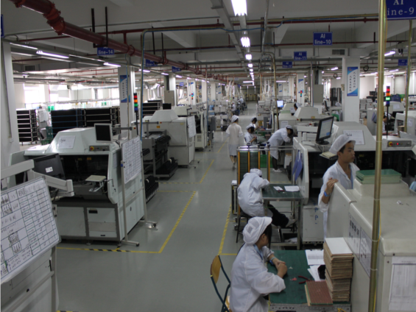
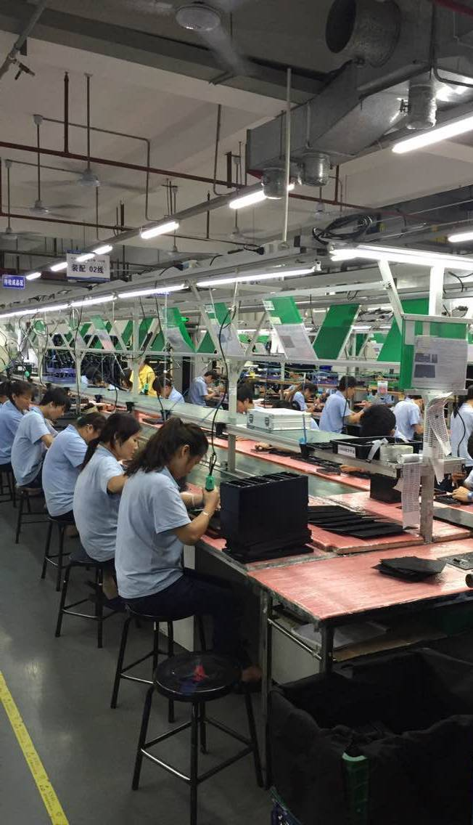
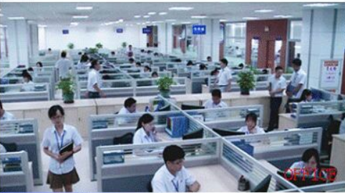

Slide 14
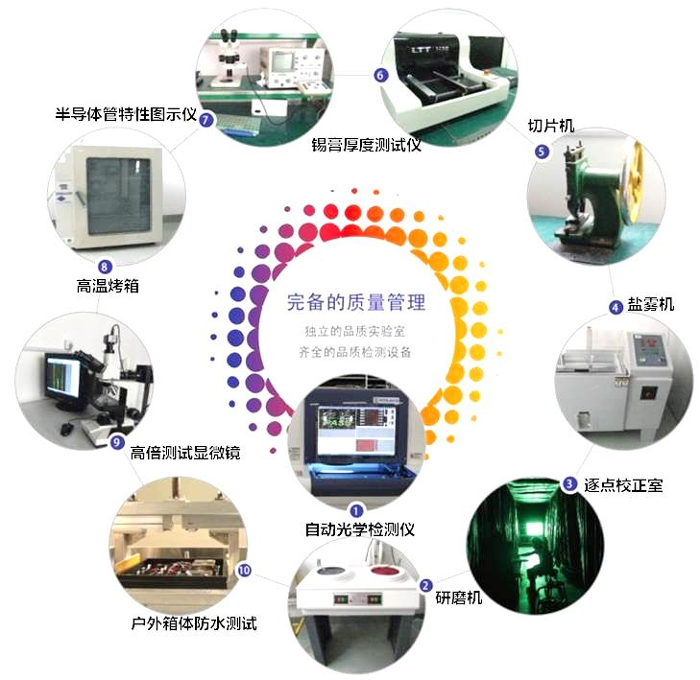
Production strength--
6 Sigma Quality Control
Quality management system：
Introduce Lean Production mode；
Improve management system by introducing Six Sigma；
100% process inspection and 100% ageing test
Develop industry’s most rigorous and complete production line standard, as many as 135 items

Slide 15

Production strength--
Quality Advantage
safe reliability 100%
Few Customer
complaint
0.01%
Few Failure Rate
0.064%
Because we believe that quality is lifeline
15

Slide 16
Production strength--
Advantages of delivery
Fastest delivery in industry
Regular inventory product delivery：2－5days
Special customized products delivery：within 15days
whole screen :3-20days
16

Slide 17

Product

Slide 18
Full color series
outdoor
Q5、Q6 、 Q6.66、Q8(1/4S)、Q8(1/5S)、Q10(1/2S)、 Q10(1/4S
Q series
Indoor
Q6、Q5、Q4、Q3、Q2.5、Q2
S series
outdoor
S4、 S5、S6 、 S6.66、S8(1/4S)、S8(1/5S)、S10(1/2S Or 1/4))、S16
T series
Indoor
T2.5-Q、T1.66、T1.92 、T2.5、T2.5-1

Slide 19
Full color series
Outdoor
A5、A6、A8、A10、A16
A series
Indoor
A2.5、A3、A4、A5
Outdoora
N625、N595, N481
500X500 series
Indoor
D481、D391

Slide 20
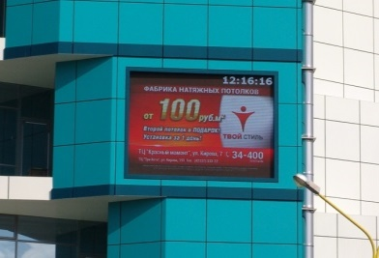
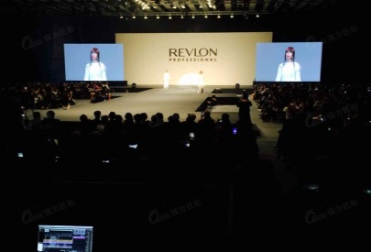
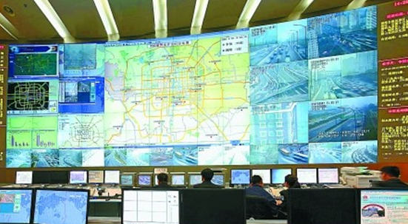
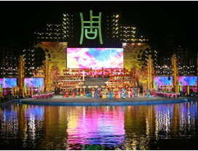
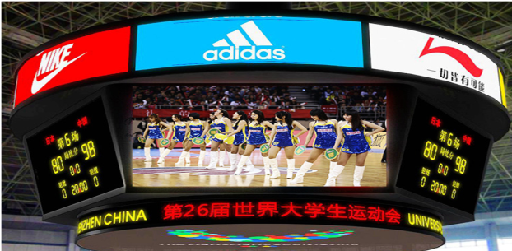
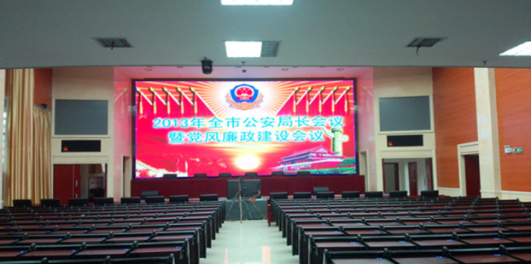
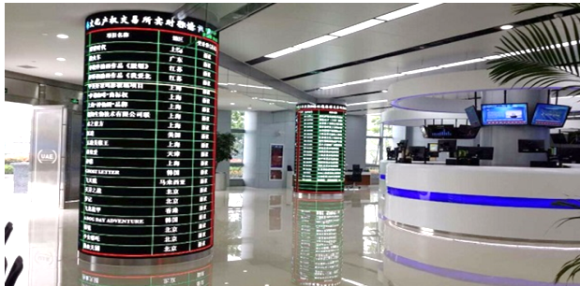
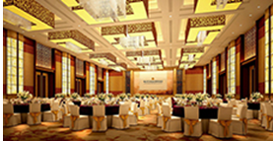
Project Case
Qiangli Jucai’s project cases are are bulit all over the world
Advertising media
Entertainment culture
Transportation
The theme park
Sports field
Meeting area
Financial area
hotel area

Slide 21
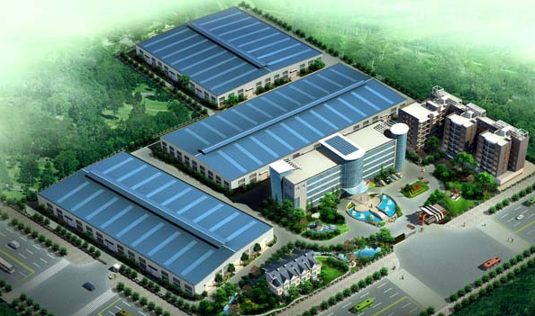
Research and development building under construction

Slide 22
Thank you !
Qiangli jucai
your most reliable partner for led screen ☺

